Slide 1
CHAPTER 1
INTRODUCTION
Prem Mann, Introductory Statistics, 8/E Copyright © 2013 John Wiley & Sons. All rights reserved.

Slide 2
WHAT IS STATISTICS?
Definition
Statistics is the science of collecting, analyzing, presenting, and interpreting data, as well as of making decisions based on such analyses.
Prem Mann, Introductory Statistics, 8/E Copyright © 2013 John Wiley & Sons. All rights reserved.

Slide 3
Statistical Question?
Is this class representative of the students who attend UWB?
Collect, analyze, present, interpret data, and make a decision based on your analyses.
Notes:
1. Discuss.
2. Everyone empty your pockets. Collect data on money in pocket and “Collect, analyze, present, interpret data, and make a decision based on your analyses.”

Slide 4
TYPES OF STATISTICS
Definition
Inferential Statistics consists of methods that use sample results to help make decisions or predictions about a population.
Prem Mann, Introductory Statistics, 8/E Copyright © 2013 John Wiley & Sons. All rights reserved.

Slide 5
POPULATION VERSUS SAMPLE
Definition
A population consists of all elements – individuals, items, or objects – whose characteristics are being studied. The population that is being studied is also called the target population.
A portion of the population selected for study is referred to as a sample.
Prem Mann, Introductory Statistics, 8/E Copyright © 2013 John Wiley & Sons. All rights reserved.

Slide 6
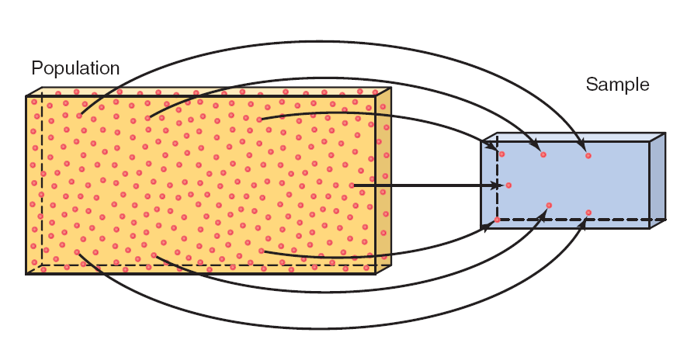
Figure 1.1 Population and Sample
Prem Mann, Introductory Statistics, 8/E Copyright © 2013 John Wiley & Sons. All rights reserved.

Slide 7
POPULATION VERSUS SAMPLE
Definition
A survey that includes every member of the population is called a census. The technique of collecting information from a portion of the population is called a sample survey.
Prem Mann, Introductory Statistics, 8/E Copyright © 2013 John Wiley & Sons. All rights reserved.

Slide 8
POPULATION VERSUS SAMPLE
Definition
A sample that represents the characteristics of the population as closely as possible is called a representative sample.
Prem Mann, Introductory Statistics, 8/E Copyright © 2013 John Wiley & Sons. All rights reserved.

Slide 9
POPULATION VERSUS SAMPLE
Definition
A sample drawn in such a way that each element of the population has a chance of being selected is called a random sample. If all samples of the same size selected from a population have the same chance of being selected, we call it simple random sampling. Such a sample is called a simple random sample.
Prem Mann, Introductory Statistics, 8/E Copyright © 2013 John Wiley & Sons. All rights reserved.

Slide 10
POPULATION VERSUS SAMPLE
A sample may be selected with or without replacement.
In sampling with replacement, each time we select an element from the population, we put it back in the population before we select the next element.
Sampling without replacement occurs when the selected element is not replaced in the population.
Prem Mann, Introductory Statistics, 8/E Copyright © 2013 John Wiley & Sons. All rights reserved.

Slide 11
BASIC TERMS
Definition
An element or member of a sample or population is a specific subject or object (for example, a person, firm, item, state, or country) about which the information is collected.
Prem Mann, Introductory Statistics, 8/E Copyright © 2013 John Wiley & Sons. All rights reserved.

Slide 12
BASIC TERMS
Definition
A variable is a characteristic under study that assumes different values for different elements. In contrast to a variable, the value of a constant is fixed.
Prem Mann, Introductory Statistics, 8/E Copyright © 2013 John Wiley & Sons. All rights reserved.

Slide 13
BASIC TERMS
Definition
The value of a variable for an element is called an observation or measurement.
A data set is a collection of observations on one or more variables.
Prem Mann, Introductory Statistics, 8/E Copyright © 2013 John Wiley & Sons. All rights reserved.

Slide 14
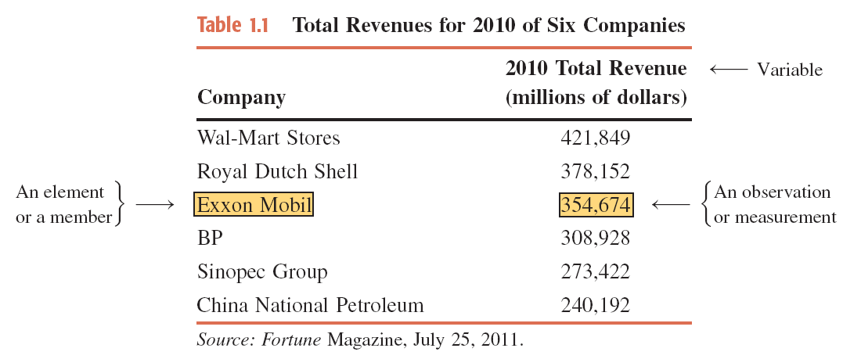
Table 1.1 Total Revenues for 2010 of Six Companies
Prem Mann, Introductory Statistics, 8/E Copyright © 2013 John Wiley & Sons. All rights reserved.

Slide 15
TYPES OF VARIABLES
Quantitative Variables
  Discrete Variables
  Continuous Variables
Qualitative or Categorical Variables
Prem Mann, Introductory Statistics, 8/E Copyright © 2013 John Wiley & Sons. All rights reserved.

Slide 16
Quantitative Variables
Definition
A variable that can be measured numerically is called a quantitative variable. The data collected on a quantitative variable are called quantitative data.
Prem Mann, Introductory Statistics, 8/E Copyright © 2013 John Wiley & Sons. All rights reserved.

Slide 17
Quantitative Variables: Discrete
Definition
A variable whose values are countable is called a discrete variable. In other words, a discrete variable can assume only certain values with no intermediate values.
Prem Mann, Introductory Statistics, 8/E Copyright © 2013 John Wiley & Sons. All rights reserved.

Slide 18
Quantitative Variables: Continuous
Definition
A variable that can assume any numerical value over a certain interval or intervals is called a continuous variable.
Prem Mann, Introductory Statistics, 8/E Copyright © 2013 John Wiley & Sons. All rights reserved.

Slide 19
Qualitative or Categorical Variables
Definition
A variable that cannot assume a numerical value but can be classified into two or more nonnumeric categories is called a qualitative or categorical variable. The data collected on such a variable are called qualitative data.
Prem Mann, Introductory Statistics, 8/E Copyright © 2013 John Wiley & Sons. All rights reserved.

Slide 20
CROSS-SECTION VS. TIME-SERIES DATA
Cross-Section Data
Time-Series Data
Prem Mann, Introductory Statistics, 8/E Copyright © 2013 John Wiley & Sons. All rights reserved.

Slide 21
Cross-Section Data
Definition
Data collected on different elements at the same point in time or for the same period of time are called cross-section data.
Prem Mann, Introductory Statistics, 8/E Copyright © 2013 John Wiley & Sons. All rights reserved.

Slide 22
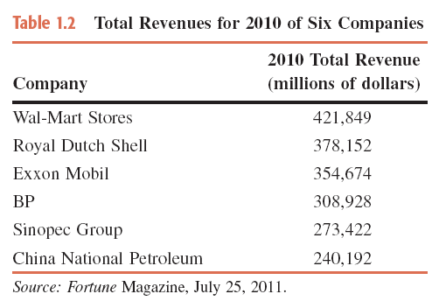
Table 1.2 Total Revenues for 2010 of Six Companies
Prem Mann, Introductory Statistics, 8/E Copyright © 2013 John Wiley & Sons. All rights reserved.

Slide 23
Time-Series Data
Definition
Data collected on the same element for the same variable at different points in time or for different periods of time are called time-series data.
Prem Mann, Introductory Statistics, 8/E Copyright © 2013 John Wiley & Sons. All rights reserved.

Slide 24
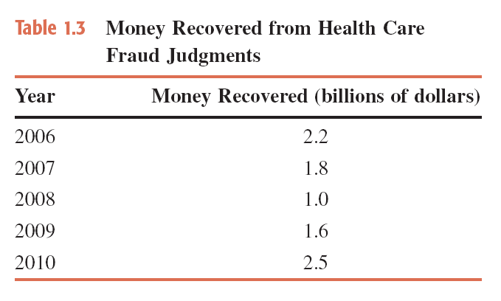
Table 1.3 Money Recovered from Health Care Fraud Judgments
Prem Mann, Introductory Statistics, 8/E Copyright © 2013 John Wiley & Sons. All rights reserved.

Slide 25
SOURCES OF DATA
Data may be obtained from
  Internal Sources
  External Sources
  Surveys and Experiments
Prem Mann, Introductory Statistics, 8/E Copyright © 2013 John Wiley & Sons. All rights reserved.

Slide 26
SUMMATION NOTATION
Suppose a sample consists of five books, and the prices of these five books are
$175, $80, $165, $97, and $88
The variable price of a book: x
Price of the first book = x₁ = $175
Price of the second book = x₂ = $80
Price of the third book = x₃ = $165
Price of the fourth book = x₄ = $97
Price of the fifth book = x₅ = $88
Prem Mann, Introductory Statistics, 8/E Copyright © 2013 John Wiley & Sons. All rights reserved.

Slide 27
SUMMATION NOTATION
Adding the prices of all five books gives
x₁+x₂+x₃+x₄+x₅ = 175+80+165+97+88 = 605
Σx = x₁+x₂+x₃+x₄+x₅ = 605
Prem Mann, Introductory Statistics, 8/E Copyright © 2013 John Wiley & Sons. All rights reserved.

Slide 28
Example 1-1
Annual salaries (in thousands of dollars) of four workers are 75, 90, 125, and 61, respectively. Find
    (a) ∑x (b) (∑x)² (c) ∑x²
Prem Mann, Introductory Statistics, 8/E Copyright © 2013 John Wiley & Sons. All rights reserved.

Slide 29
Example 1-1: Solution
(a) ∑x = x₁ + x₂ + x₃ + x₄
= 75 + 90 + 125 + 61
= 351 = $351,000
(b) Note that (∑x)² is the square of the sum of all x values.
Thus,
(∑x)² = (351)² = 123,201
Prem Mann, Introductory Statistics, 8/E Copyright © 2013 John Wiley & Sons. All rights reserved.

Slide 30
Example 1-1: Solution
(c) The expression ∑x² is the sum of the squares of x values.
To calculate ∑x² , we first square each of the x values and
then sum these squared values. Thus,
∑x² = (75)² + (90)² + (125)² + (61)²
= 5,625 + 8,100 + 15,625 + 3,721
= 33,071
Prem Mann, Introductory Statistics, 8/E Copyright © 2013 John Wiley & Sons. All rights reserved.

